Slide 1

PROJECT OVERVIEW
EASY
ADVANCED

Slide 2
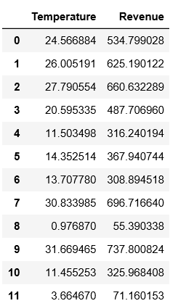

PROJECT OVERVIEW
You own an ice cream business and you would like to create a model that could predict the daily revenue in dollars based on the outside air temperature (degC).
Dataset:
Input (X): Outside Air Temperature
Output (Y): Overall daily revenue generated in dollars
REVENUE($)
TEMPERATURE (DegC)
Source: https://www.goodfreephotos.com/vector-images/ice-cream-stand-vector-clipart.png.php

Slide 3
SIMPLE LINEAR REGRESSION 101
EASY
ADVANCED

Slide 4
SIMPLE LINEAR REGRESSION 101
In simple linear regression, we predict the value of one variable Y based on another variable X.
X is called the independent variable and Y is called the dependant variable.
Why simple? Because it examines relationship between two variables only.
Why linear? when the independent variable increases (or decreases), the dependent variable increases (or decreases) in a linear fashion.
REVENUE($)
TEMPERATURE (DegC)

Slide 5



SIMPLE LINEAR REGRESSION 101: SOME MATH!
Goal is to obtain a relationship (model) between outside air temperature and ice cream sales revenue. Simply you need to find “m” and “b”.
This “trained” model can be later used to predict any Revenue (dollars) based on the outside air Temperature.
MODEL! (GOAL)
$840
$$y=b+m∗x$$
REVENUE($)
$$m$$
DEPENDANT VARIABLE
REVENUE ($)
INDEPENDENT VARIABLE
TEMPERATURE (DegC)
$$b$$
40 degC
Temperature (x) = 40 degC
Revenue (y) = $840
TEMPERATURE (DegC)

Slide 6
LEAST SUM OF SQUARES
EASY
ADVANCED

Slide 7
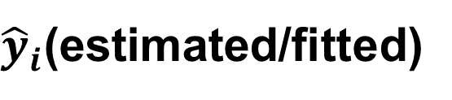
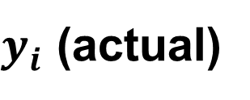

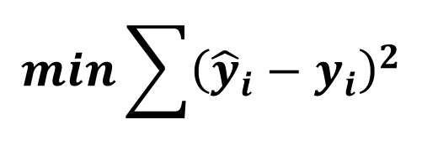
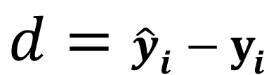
HOW TO GET MODEL PARAMETERS? LEAST SUM OF SQUARES
Least squares fitting is a way to find the best fit curve or line for a set of points.
The sum of the squares of the offsets (residuals) are used to estimate the best fit curve or line.
Least squares method is used to obtain the coefficients m and b.
$y_{i}$ (actual)
$$d={\hat{y}}_{i}−y_{i}$$
$$d$$
REVENUE($)
$$min\sum{{\left({\hat{y}}_{i}−y_{i}\right)}^{2} }$$
${\hat{y}}_{i}$(estimated/fitted)
MINIMUM (LEAST) SUM OF SQUARES
TEMPERATURE (DegC)

Slide 8
TRAINING VS. TESTING DATASET
Data set is divided into 75% for training and 25% for testing.
Training set: used for model training.
Testing set: used for testing trained model. Make sure that the testing dataset has never been seen by the trained model before.
75% TRAINING
TOTAL DATA
25% TESTING

Slide 9
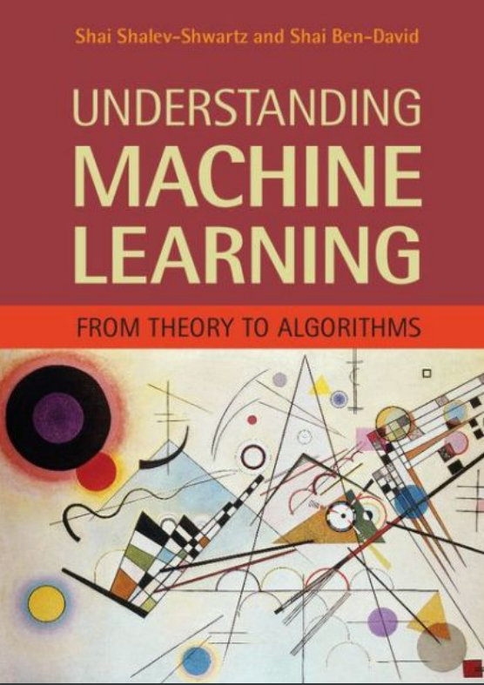
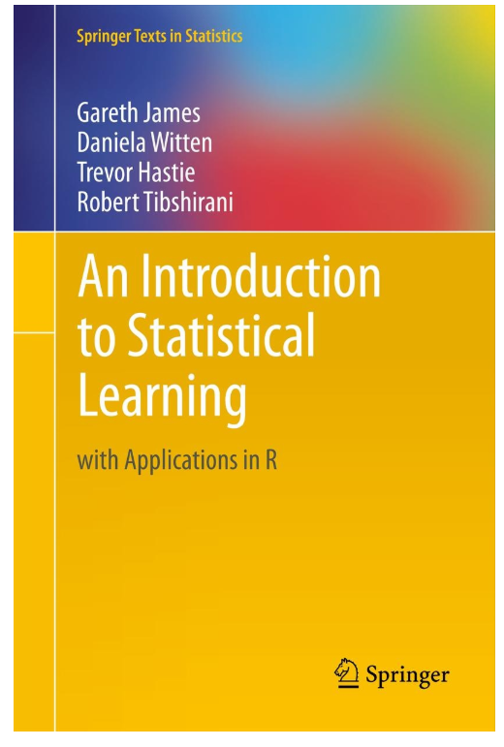
SIMPLE LINEAR REGRESSION: ADDITIONAL READING MATERIAL
Additional Resources, Page #123: http://www.cs.huji.ac.il/~shais/UnderstandingMachineLearning/understanding-machine-learning-theory-algorithms.pdf
Additional Resources, Page #61:
http://www-bcf.usc.edu/~gareth/ISL/ISLR%20Seventh%20Printing.pdf

Slide 10






SIMPLE LINEAR REGRESSION: PRACTICE OPPORTUNITY
Match the equations to the figures:
$$y=3∗x$$
$$y=15−10∗x$$
$$y$$
$$y$$
$$x$$
$$x$$

Slide 11
SCIKIT-LEARN 101
EASY
ADVANCED

Slide 12
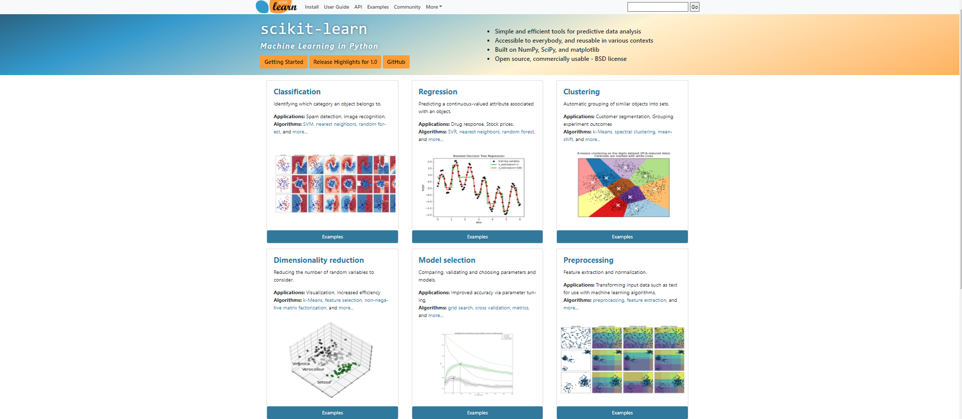
SCIKIT-LEARN 101
Scikit-learn is a free machine learning library developed for python.
Scikit-learn offers several algorithms for classification, regression, and clustering.
Several famous models are included such as support vector machines, random forests, gradient boosting, and k-means.
Scikit learn can be efficiently used in data preprocessing.

Slide 13
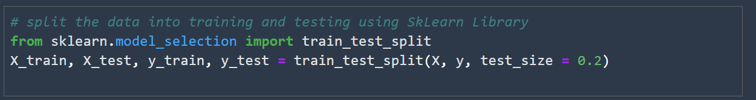
SCIKIT-LEARN 101: PERFORM DATA PRE-PROCESSING
SCIKIT-Learn library is mostly used for data preprocessing such as standardization, scaling, normalization, and performing train test split.

Slide 14
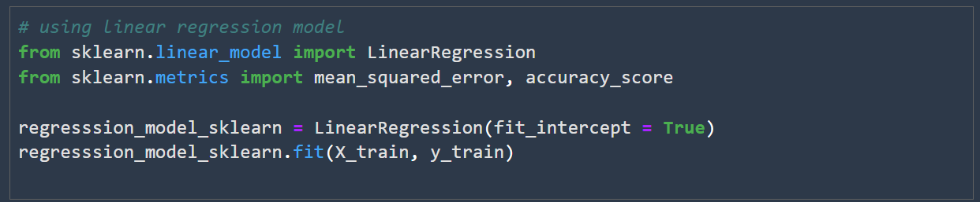
SCIKIT-LEARN 101: TRAIN A MACHINE LEARNING REGRESSION MODEL
Check out the simple Linear Regression Examples in Scikit-Learn documentation:
https://scikit-learn.org/stable/auto_examples/linear_model/plot_ols.html#sphx-glr-auto-examples-linear-model-plot-ols-py

Slide 15
NOTEBOOK CODE DEMO
EASY
ADVANCED

Slide 16
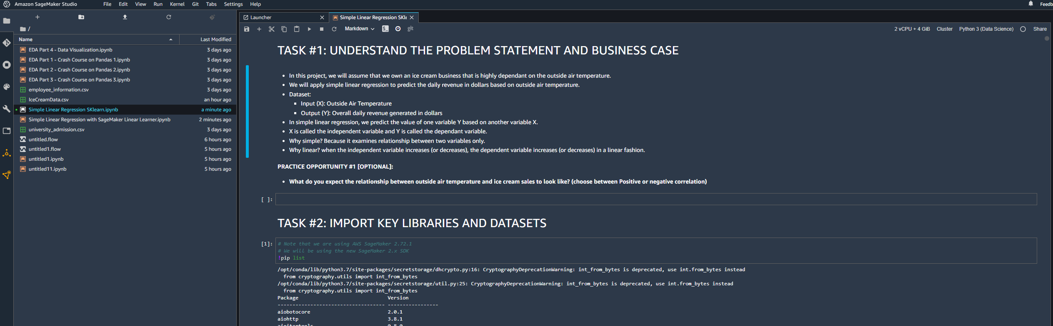
NOTEBOOK DEMO

Slide 17
END-OF-DAY
PROJECT
EASY
ADVANCED

Slide 18
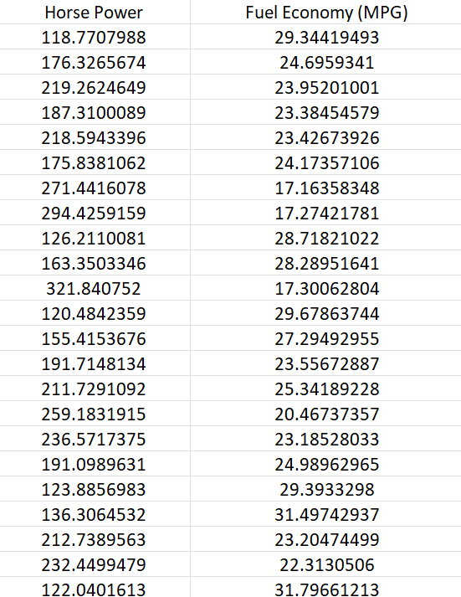
END-OF-DAY PROJECT
You have been hired as a consultant to a major Automotive Manufacturer and you have been tasked to develop a model to predict the impact of increasing the vehicle horsepower (HP) on fuel economy (Mileage Per Gallon (MPG)). You gathered the following dataset:
Independent variable X: Vehicle Horsepower
Dependent variable Y: Mileage Per Gallon (MPG)

Slide 19
END-OF-DAY PROJECT
Using the skeleton jupyter notebook “Simple Linear Regression - Fuel Consumption Project Questions”, perform the following:
1. Load the “FuelEconomy.csv” dataset
2. Perform data visualization and basic exploratory data analysis
3. Split the data into 80% for training and 20% for testing
4. Train a machine linear regression model in Scikit-Learn
5. Assess trained model performance

